Slide 1


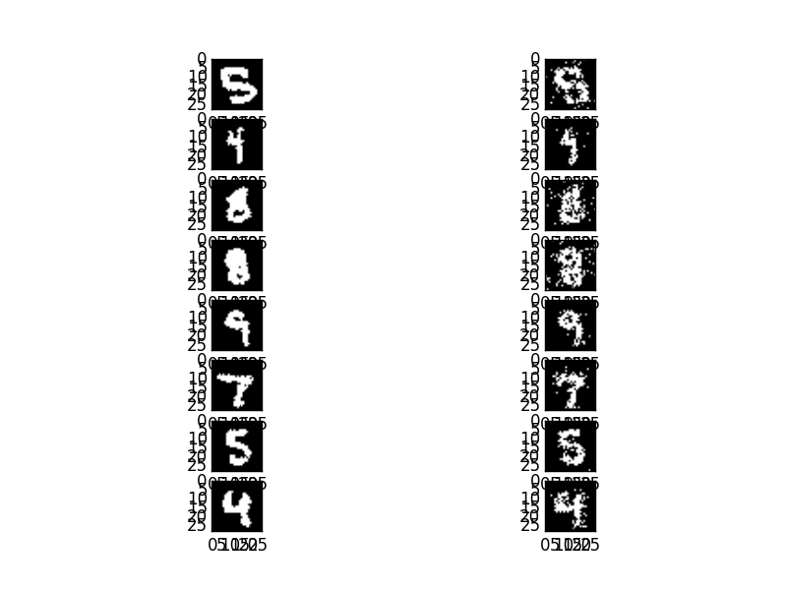


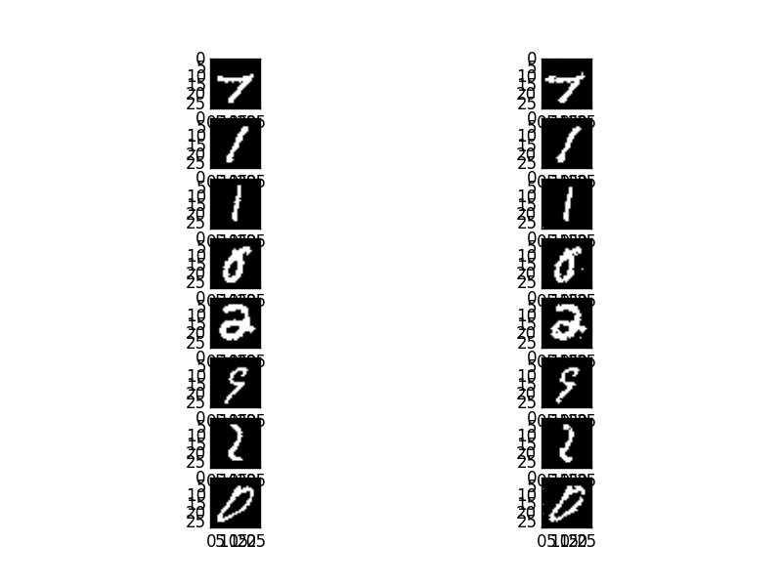
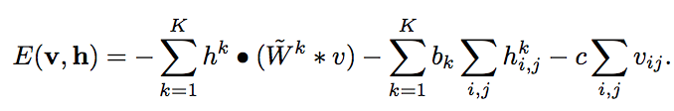
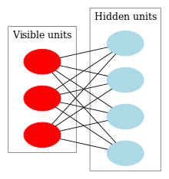
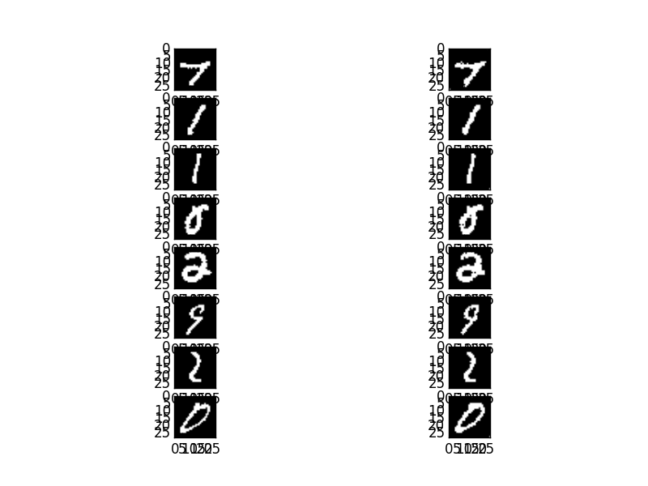
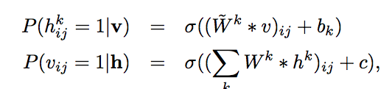
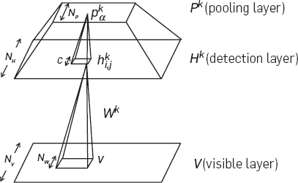
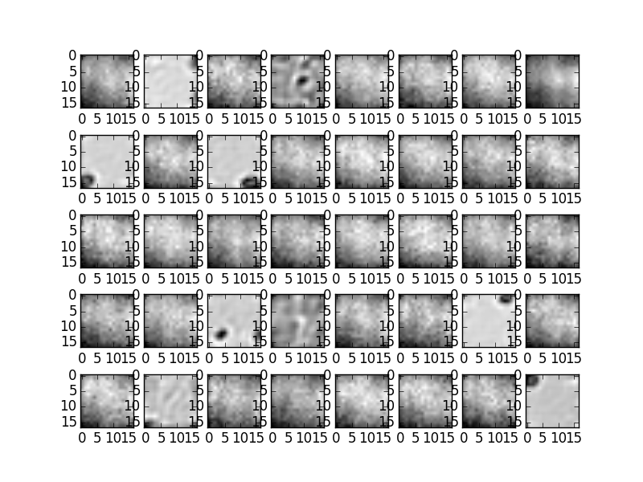
Comparison of RBM Models
Sam Bean
University of Michigan
Introduction
Methods
Results
Sparsity Regularization
Handwriting recognition is an extensively researched subject that has long used specialized single features to achieve their results. However, recent unsupervised feature learning algorithms have had similar success to these hand engineered methods. These recent developments have shown that leveraging the massive amount of unlabeled data is a promising way to avoid additional overhead in object recognition tasks.
My work revolved around implementing and comparing different variations of the restricted Boltzmann machine (RBM). The variants discussed will be the standard RBM, the convolutional RBM (CRBM), and a CRBM with sparsity regularization.
These models became increasingly used when it was realized that training RBM's layerwise could be used to build deeper architectures. Each layer consists of feature detectors where each successive layer detects more complicated patterns in the input data.
RBM energy function given a configuration of neurons:
The parallel updates for neurons is given by:
Where sigma is the sigmoid function. If this value is greater than a randomly generated number between 0 and 1 then we set the neuron to be on.
CRBM energy function:
In the above equation, the dot is an element-wise multiplication and the * is the convolution operator.
With this energy function we can define another set of updates for the convolutional restricted Boltzmann machine.
Example, reconstruction pairs are shown to the left.
The top sample shows an RBM generating the data. This model had an average of 53 pixels incorrect per image
The middle example shows a CRBM with a sparsity of 5% in the hidden layer. This model got 25 pixels wrong on average.
The final example is a CRBM with a sparsity of 1% in the hidden layer. This got only 19 pixels wrong per image. The model actually fills in a gap left by the author in the handwritten 9.
Below are examples of filters developed by the CRBM algorithm
During testing I discovered a way to enforce sparsity on the model globally. Instead of the squared expectation I followed Hinton's "Practical Guide to Training Restricted Boltzmann Machines" which uses cross-entropy to measure the difference between the desired and actual sparsity. This differs from Lee's method since only the squared expectation of hidden units is used without any actual target. Also, as suggested by Hinton, the penalty is inflicted to both the weights and the hidden biases instead of only biases. The algorithm also applies the penalty before the pooling stage instead of during.
Conclusion
All variants of the RBM use undirected, bipartite graphs to automatically learn feature detectors. The learning is completely unsupervised which allows the use the massive quantity of unlabeled data available. Block Gibbs sampling with contrastive divergence is used to train the model which was intractable before the advent of these algorithms. I hope to have illustrated the clear advantages of the more CRBM in both final pixel accuracy and convergence speed.
Bibliography
CRBM Architecture
Filter Maps
[1] Smolensky, Paul (1986). "Chapter 6: Information Processing in Dynamical Systems: Foundations of Harmony Theory". In Rumelhart, David E.; McLelland, James L. Parallel Distributed Processing: Explorations in the Microstructure of Cognition, Volume 1: Foundations. MIT Press. pp. 194–281. ISBN 0-262-68053-X.
[2] Hinton, G. E. (2002). "Training Products of Experts by Minimizing Contrastive Divergence". Neural Computation 14 (8): 1771-1800. doi:10.1162/089976602760128018. PMID 12180402.
[3] Geoffrey Hinton (2010). A Practical Guide to Training Restricted Boltzmann Machines. UTML TR 2010-003, University of Toronto.
[4] Honglak Lee , Roger Grosse , Rajesh Ranganath , Andrew Y. Ng, Convolutional deep belief networks for scalable unsupervised learning of hierarchical representations, Proceedings of the 26th Annual International Conference on Machine Learning, p.609-616, June 14-18, 2009, Montreal, Quebec, Canada. doi:10.1145/1553374.1553453
[5] H. Lee, C. Ekanadham, and A. Ng, "Sparse deep belief net model for visual area V2," in Advances in Neural Information Processing Systems 20 (NIPS'07), (J. Platt, D. Koller, Y. Singer, and S. P. Roweis, eds.), Cambridge, MA: MIT Press, 2008.
[6] H. Lee, A. Battle, R. Raina, and A. Ng, "Efficient sparse coding algorithms," in Advances in Neural Information Processing Systems 19 (NIPS'06), (B. Schölkopf, J. Platt, and T. Hoffman, eds.), pp. 801-808, MIT Press, 2007.
An example of an RBM. The visible units correspond to pixels of an image. The hidden units are feature detectors that allows the model to recreate the input data. This is known as the generative setting of machine learning. However, RBM’s can be trained for reconstruction then used for classification. But data generation will only be discussed here.
CRBM’s are composed of a visible layer, a hidden layer, and a pooling layer which performs max pooling. The final layer is omitted in my implementation. Figure courtesy of Honglak Lee.

